Slide 1

CMR COLLEGE OF ENGINEERING & TECHNOLOGY
Kandlakoya, Medchal, Hyderabad - 501401
Department of Computer Science and Engineering
Prediction of Amyloid Protein Using Gradient Boosting Model
Name of the student:
20H51A05G4 B.Varshith
20H51A0529 A.Sindhuja
20H51A05J5 N.Sai Aditya Vardhan
Batch No: 48
Under esteemed guidance of
Mr.M.SHIVA KUMAR
(Assistant Professor)
Batch: 2020-2024 Major Project Phase 2

Slide 2
Outline
Abstract
Introduction
Literature survey
Existing system
- Problems in existing system
Research Objective of Presentation
Problem Definition
Research work
- Proposed system architecture
- Methods
- Comparison of Proposed system with an existing system
Performance Measure
Results
Conclusion
Future Work
References
Notes:
2

Slide 3
Abstract
Notes:
3

Slide 4
ABSTRACT
Amyloid proteins are associated with a great variety of human diseases including Alzheimer’s, Parkinson's, and type2diabetes.
Certain vegetables and food items can help the humans to prevent such diseases by controlling the deposition of Amyloid proteins. Vegetables includes onions, kale, romaine lettuce, cabbage, and tomatoes. Other food items like walnuts, coffee, Berries, Fatty Fish, Turmeric, Champagne and Cinnamon also help in the control of diseases that are caused by the deposition of Amyloids.
In this project, is to predict Amyloid Proteins by considering a dataset comprising of the above mentioned food items. This data analysis is carried out by using Gradient Boosting Classifier and Neural Net Analysis.

Slide 5
INTRODUCTION
Notes:
5

Slide 6
Introduction
In the pursuit of mitigating diseases associated with amyloid proteins, our project leverages the power of Gradient Boosting classifiers and Neural Networks.
Gradient Boosting, renowned for its capacity to decipher intricate patterns, combines weak models to predict amyloid protein levels.
Meanwhile, Neural Networks, inspired by the human brain's adaptability, excel in recognizing dynamic relationships within dietary data.
By harmonizing these advanced techniques, our project aims to predict amyloid proteins based on dietary habits, providing individuals with insights to make informed health-conscious choices and prevent amyloidosis-related diseases
Notes:
6

Slide 7
Literature Survey
Notes:
7

Slide 8
Existing system
FastNCA: This technique excels at reducing data complexity, but its focus might not be ideal for classifying amyloids. Additionally, it can be susceptible to overfitting, leading to unreliable predictions on new data.
Decision Tree: While interpretable, decision trees struggle with non-linear relationships between food and amyloids. They can also be sensitive to slight variations in the data, potentially impacting prediction accuracy.
KNN (K-Nearest Neighbors): KNN relies on a distance metric to classify data points. However, choosing the right metric can be challenging for complex datasets like yours. Additionally, KNN's accuracy can suffer in high-dimensional scenarios (many food items).
Embedded Evolutionary & Ensemble Feature Selection: This approach can be computationally expensive, especially for large datasets. Moreover, the chosen feature selection method might not be perfect for capturing the key features influencing amyloid protein levels in food intake data.

Slide 9
Problems in Existing system
FastNCA:
Prone to overfitting, especially with high-dimensional data, leading to unreliable predictions on unseen examples.
Primarily focused on dimensionality reduction, may not be ideal for complex classification tasks like amyloid protein level prediction.
Decision Tree:
Creates inflexible decision boundaries, struggling with data containing non-linear relationships between features (e.g., food items and amyloid levels).
Sensitive to small changes in the data, potentially leading to inaccurate predictions on slightly different food combinations.
KNN (K-Nearest Neighbors):
Performance heavily relies on the chosen distance metric, which might not effectively capture the relationships between food items in your dataset.
Accuracy can suffer with high-dimensional data (many food items) due to the "curse of dimensionality."
Embedded Evolutionary & Ensemble Feature Selection:
Can be computationally expensive, especially for large datasets, increasing training time.
The chosen feature selection method might not be optimal for the specific task of predicting amyloid protein levels from food intake data

Slide 10
Research Objective
Notes:
10

Slide 11
Research objective
The primary research objective of this project is to develop predictive models using Gradient Boosting Classifier and Neural Network Analysis to accurately predict amyloid protein levels based on dietary habits.
By analyzing a dataset encompassing various food items known to impact amyloidosis, our aim is to empower individuals with valuable insights for disease prevention, specifically targeting conditions such as Alzheimer's, Parkinson's, and type 2 diabetes, ultimately contributing to improved health outcomes through informed dietary choices.

Slide 12
Problem Definition
Notes:
12

Slide 13
Problem Definition
In the existing system, Amyloidosis patients are approaching doctors after they are effected by the disease. Prevention is always better than cure. The proposed system is helpful to prevent the disease by predicting the Amloyds based on the food habits, so that people can change their food habits and there by prevent the occurence of Amyloidosis.

Slide 14
Research Work
Notes:
14

Slide 15
Architecture / Block Diagram
Notes:
15

Slide 16
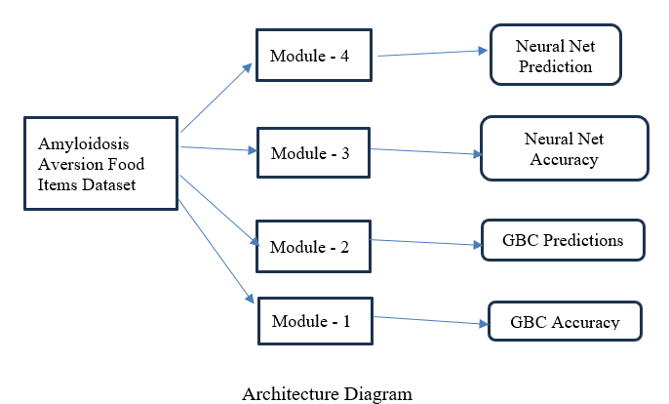
Architecture / Block Diagram

Slide 17
Proposed Methods
Notes:
17

Slide 18
Proposed Methods
Gradient Boosting Classification
Neural Net Classification

Slide 19
Proposed Methods
Our project aims to predict Amyloid Proteins through advanced machine learning techniques, focusing on Gradient Boosting Classification as a primary method.
Additionally, we will employ Neural Net Classification to enhance the accuracy and robustness of our predictions, leveraging the power of deep learning in protein classification.
The Gradient Boosting model will be fine-tuned to effectively capture complex patterns in protein data, providing a robust and interpretable predictive framework.
The integration of both Gradient Boosting Classification and Neural Net Classification ensures a comprehensive and synergistic approach for accurate prediction of Amyloid Proteins in our study.

Slide 20
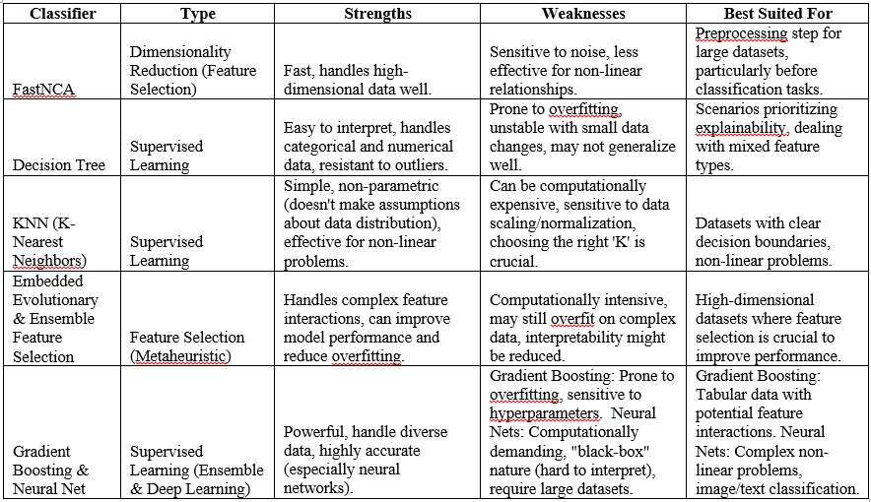
Comparison Of Proposed System with an existing system:

Slide 21
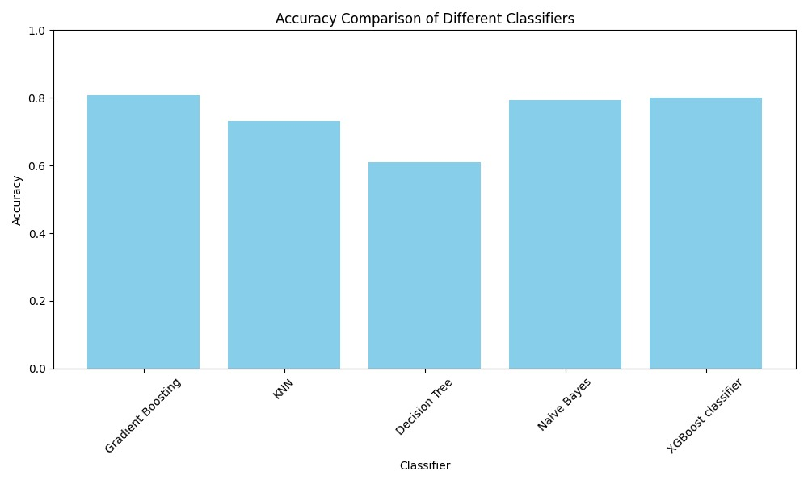
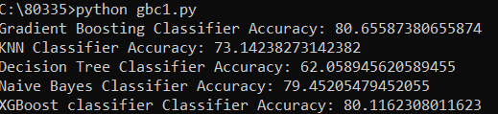
Performance Measure:

Slide 22
Result
This section showcases our project's functionality through a series of steps and accompanying visuals.
Executing the Application:
1. Launch the Command Prompt as Administrative.
2. Navigate to the Project Directory: This step instructs the program on location of the necessary files.
3. Run the File amlyproteinl1.py: Executing this file initiates the application.
Upon program execution, the "Amyloid Proteins Prediction Tool" window launches as shown in Fig: 3. This interface comprises four distinct modules:
Gradient Boosting Accuracy: This section displays the model's overall accuracy in predicting amyloid protein level as shown in Fig: 4.
Gradient Boosting Prediction: This module showcases the model's predicted amyloid protein levels of user as shown in Fig: 5.
Neural Network Accuracy: This section presents the accuracy of the neural network model in predicting amyloid protein levels as shown in Fig: 6.
Neural Network Prediction: This module displays the neural network model's predicted amyloid protein levels of user as shown in Fig: 7.

Slide 23
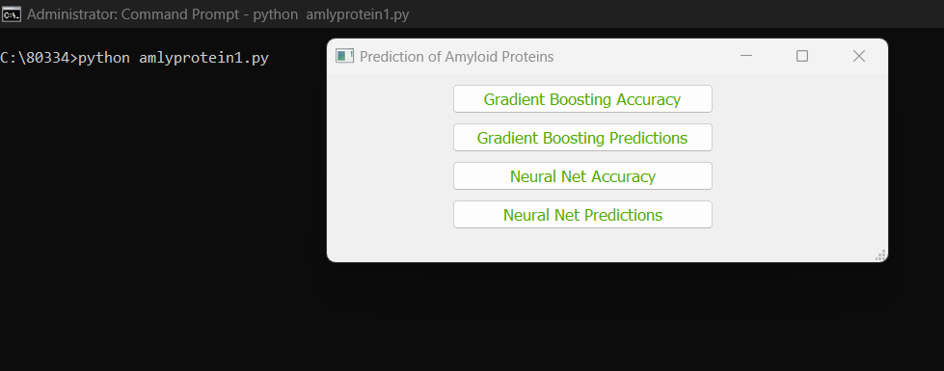
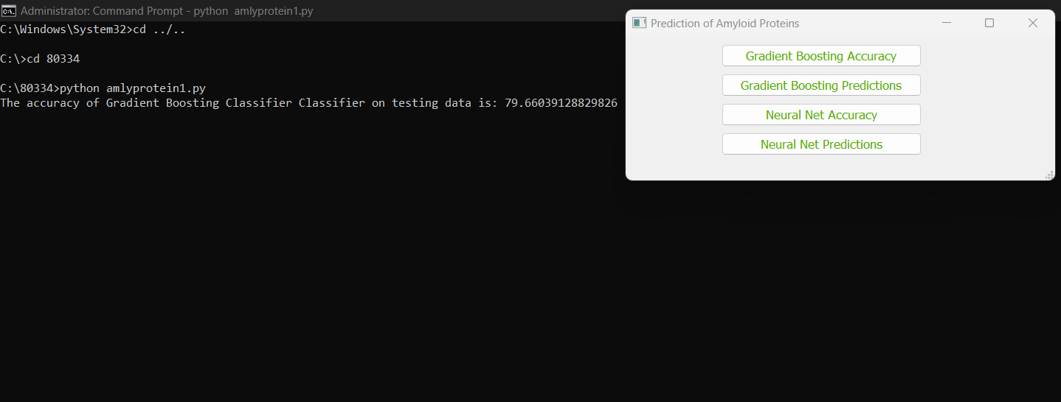
Fig: 1 Amyloid Protein Prediction Tool
Fig: 2 GBC Accuracy

Slide 24
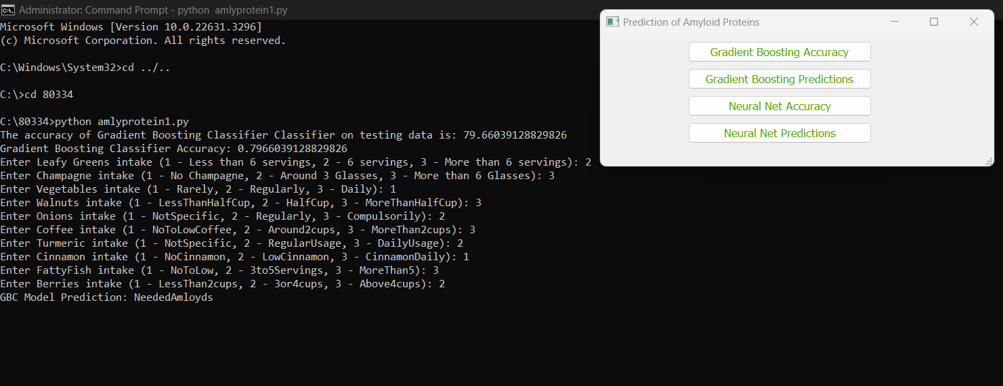
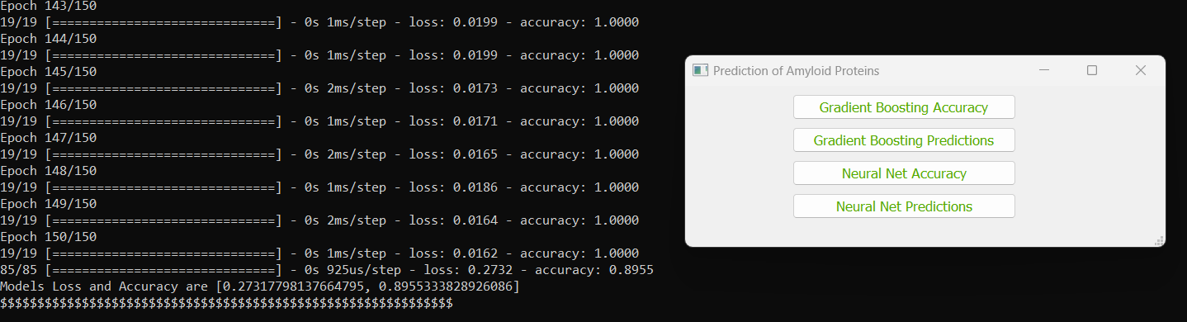
Fig: 3 GBC Prediction
Fig: 4 Neural Net Accuracy

Slide 25
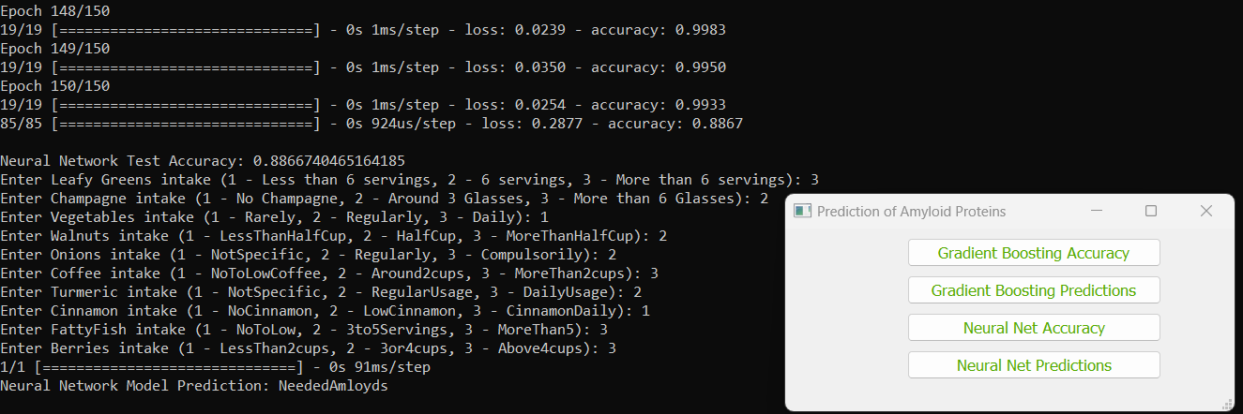
Fig: 5 Neural Net Prediction

Slide 26
Conclusion
Our study successfully developed and evaluated two machine learning models: Gradient Boosting Classifier (GBC) and a Neural Network. These models aim to predict the quantity of amyloid protein in various foods, including common ones like onions, kale, and berries. Both models performed well on entirely new data, suggesting they might possess the ability to identify foods linked to various levels of amyloid proteins.
The GBC model attained a accuracy of 79.6%, while the Neural Network reached 89%. Notably, both models could predict the amyloid protein levels in unseen food items.
Overall, this project contributes to the field of using ML (machine learning) to analyze dietary patterns. It makes room for more research into the connection between specific foods and the accumulation of amyloid proteins. This research possesses the potential to educate dietary strategies for individuals worried about health problems associated with amyloid buildup.

Slide 27
Future work
Larger, Diverse Dataset: Get more data or use augmentation techniques to enhance the model's ability to handle new cases.
Feature Engineering: Include relevant features (age, genetics, etc.) and use feature selection to find the most important food factors.
Hyperparameter Optimization: Fine-tune your models' settings (learning rate, etc.) using Grid Search or similar methods.
Explore Other Algorithms: Consider Random Forest or Support Vector Machines for potential benefits.
Ensemble Methods: Combine multiple models for potentially better overall predictions.
Focus on Interpretability & UI: Use SHAP or LIME for explainability, and create a user-friendly app interface with visualizations and personalized recommendations.

Slide 28
References
[1] Q.Sun, W. Kong, X. Mou, and S. Wang, ‘‘Transcriptional regulation analysis of Alzheimer’s disease based on FastNCA algorithm,’’ Current Bioinf., vol. (14), no. 8, pp. 771–782, Dec. 2019.
[2] Ishahid Akbar, Hashim Ali, Ashfaq Ahmad, Mahidur R. Sarker,Aamir Saeed, Ely Salwana, Sarah Gul, Ahmad Khan1 And Farman AL: Prediction of Amyloid Proteins Using Embedded Evolutionary & Ensemble Feature Selection Based Descriptors With eXtreme Gradient Boosting Model, IEEE Access
[3] P. Lembré, C. Vendrely, and P. Martino, ‘‘Identification of an amyloidogenic peptide from the Bap protein of Staphylococcus epidermidis,’’ Protein Peptide Lett., vol. 21, no. (1), pp. 75–79
[4] Q. Zou, K. Qu, Y. Luo, D. Yin, Y. Ju, and H. Tang, ‘‘Predicting diabetes mellitus (dm) with ML(machine learning) methods,’’ Frontiers Genet., vol. 9,p. 515..

Slide 29
Thank You!

